Slide 1

AI-Based Skill Gap Analyzer and Personalized Learning Recommendation System
SIR M. VISVESVARAYA INSTITUTE OF TCEHNOLOGY, BANGALORE
DEPARTMENT OF MCA
Project Guide Presented By
Prof. Sneha Bharti Rohanth S R
1MV24MC054

Slide 2
Introduction
In today’s rapidly evolving job market, possessing industry-relevant skills is crucial for career growth and employability. However, many candidates find it difficult to align their existing skills with specific job requirements due to a lack of proper guidance and evaluation tools. Traditional resume screening methods are often manual, time-consuming, and lack accuracy. These methods fail to provide deep insights into a candidate’s capabilities. Therefore, there is a need for an intelligent system that can automatically analyze skills and provide meaningful recommendations. This project focuses on bridging that gap using AI and NLP techniques.

Slide 3
Problem Statement
In today’s fast-changing job market, professionals and students struggle to identify which skills they currently possess and which ones they lack to meet industry expectations. Traditional resume analyzers or course recommendation platforms only perform keyword matching and fail to understand the actual context or relationships between skills.
There is a need for an AI-powered system that can intelligently analyze a person’s skill set, detect missing or underdeveloped skills, and recommend personalized learning resources for upskilling based on role-specific skill datasets.

Slide 4
Objectives
To develop an AI-based system that extracts and analyzes user skills using Natural Language Processing (NLP).
To compare user skills with job role requirements and identify missing skills.
To recommend personalized learning resources such as YouTube tutorials and online courses.
To provide a clear roadmap for users to improve their skills step by step.
To generate simple reports and analytics for better career planning.

Slide 5
Scope
Supports users in analyzing their skills and identifying gaps for different job roles.
Provides a smart platform with features like skill extraction, gap analysis, and learning recommendations.
Enables comparison of user skills with industry requirements for better career planning.
Offers clear insights and reports to help users improve their employability.
Helps users make informed decisions about their learning and career path.

Slide 6
Existing System
Existing systems, such as job portals and resume analyzers, rely mainly on keyword matching between resumes and job descriptions.
They have several limitations, including:
Inability to detect indirect or related skills.
Failure to identify specific areas where the user needs improvement.
Lack of personalized learning paths or resource recommendations.
As a result, users often fail to understand their actual learning needs and may spend unnecessary time browsing irrelevant content.

Slide 7
Proposed System
Uses AI and NLP techniques to automatically extract and analyze skills from resumes.
Identifies skill gaps by comparing user skills with job role requirements.
Provides personalized learning recommendations such as online courses and tutorials.
Offers a user-friendly dashboard with clear insights and skill reports.
Helps users improve their skills and make better career decisions.

Slide 8
Hardware and Software requirements
Hardware requirements
Processor: Intel i3 or equivalent
RAM: 4 GB
Storage: 5–10 GB free space
Internet: Required for basic functionality
Software requirements
OS: Windows / Linux / macOS
Frontend: React.js, HTML5, CSS3, Javascript
Backend: Python 3.8+
Runtime Environment: Node.js (for frontend)
Browser: Chrome / Edge

Slide 9
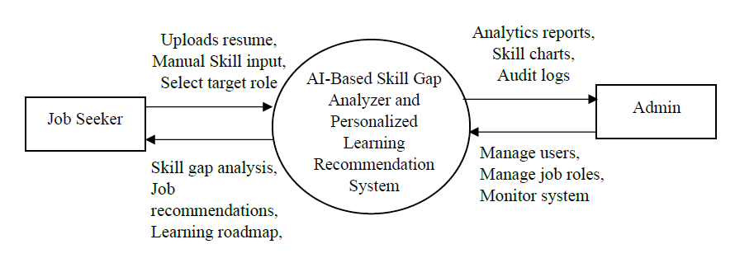
Detailed Design
DFD Level 0:

Slide 10
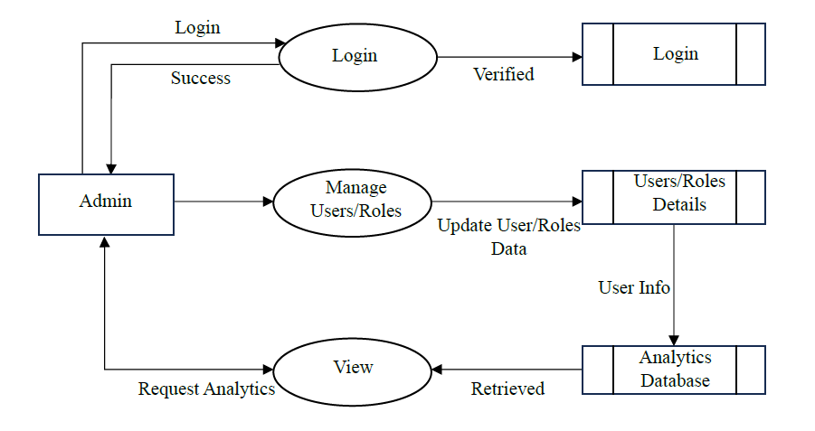
DFD Level 1:

Slide 11
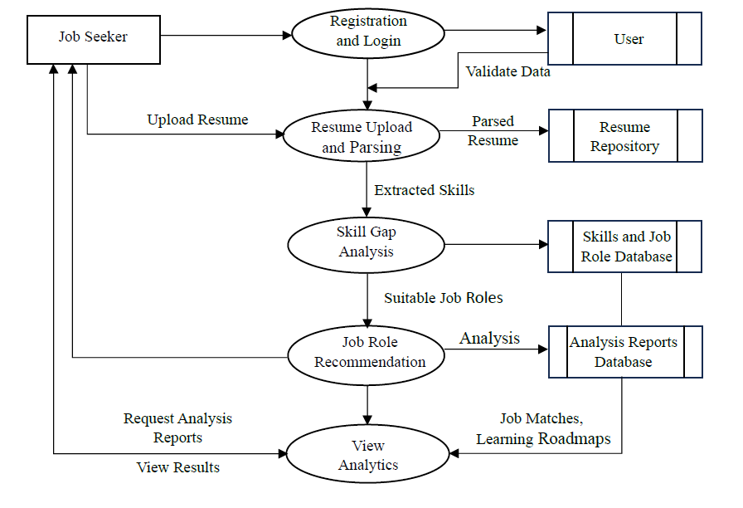
DFD Level 2:

Slide 12
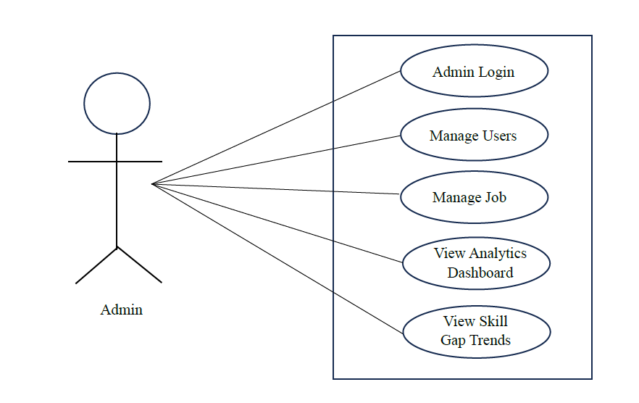
Use Case Diagram of Admin

Slide 13
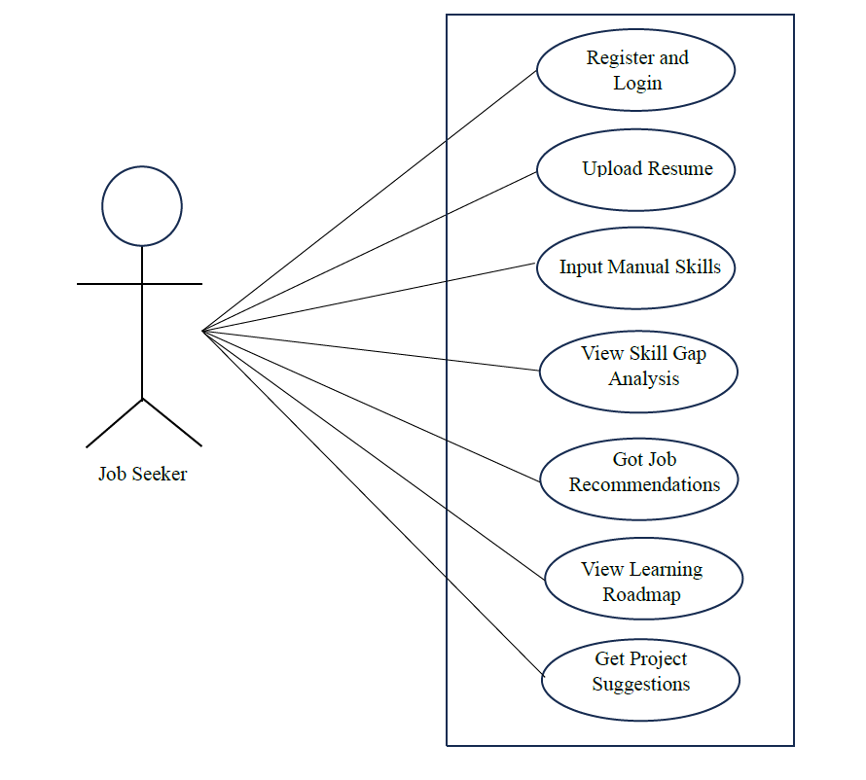
Use Case Diagram of Job Seeker

Slide 14
Algorithms - Pseudocode
spaCy (NLP - PhraseMatcher): Extracts technical skills from resume text.
Sentence-BERT (SBERT): Understands meaning of skills using semantic analysis.
TF-IDF Vectorization: Converts skills into numerical vectors.
Random Forest Classifier: Predicts suitable job roles based on skills.

Slide 15
Algorithms - Pseudocode
Pseudocode:BEGIN
INPUT Resume_File
// Step 1: Extract Text
Resume_Text ← Extract_Text(Resume_File)
// Step 2: Skill Extraction using NLP
Skills_List ← Extract_Skills_Using_spaCy(Resume_Text)
// Step 3: Convert Skills to Vector
Skill_Vector ← TFIDF_Transform(Skills_List)
// Step 4: Predict Job Role using Random Forest
Predicted_Role ← RandomForest_Model_Predict(Skill_Vector)
// Step 5: Load Job Dataset
Job_Dataset ← Load_Dataset()
// Step 6: Find Required Skills for Predicted Role
Required_Skills ← Get_Required_Skills(Job_Dataset, Predicted_Role)

Slide 16
// Step 7: Identify Skill Gap
Skill_Gap ← Required_Skills - Skills_List
// Step 8: Recommend Learning Resources
Recommendations ← Recommend_Resources(Skill_Gap)
// Step 9: Output Results
PRINT "Predicted Job Role: ", Predicted_Role
PRINT "Skill Gap: ", Skill_Gap
PRINT "Recommended Learning: ", Recommendations
END

Slide 17
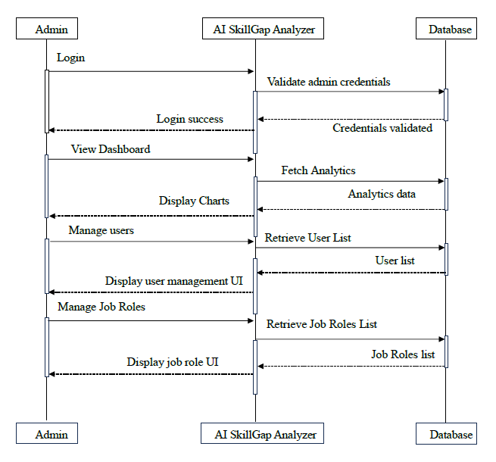
Sequence Diagram of Admin

Slide 18
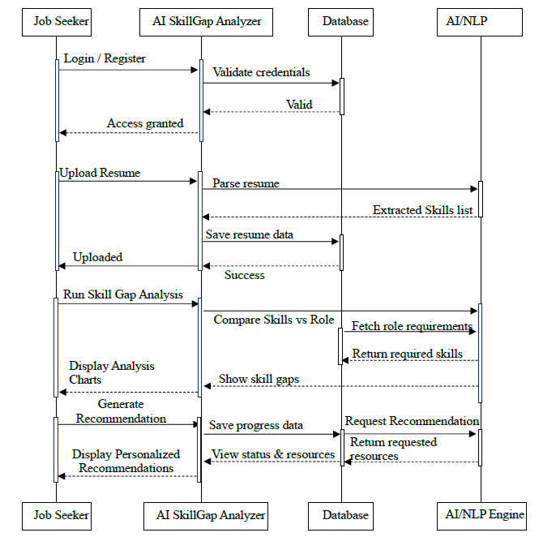
Sequence Diagram of Job Seeker

Slide 19
Dataset
Job Title | Job Description | Skills | Certifications
Admin Big Data | Responsible for managing and overseeing big data infrastructure, ensuring data integrity, security, and availability. Requires expertise in Hadoop, Spark, and data warehousing solutions. | Hadoop, Spark, MapReduce, Data Lakes, Data Warehousing, Big Data Architecture, NoSQL, Data Modeling, ETL, Cloud Computing, AWS, Azure, Data Governance, Security | Cloudera Certified Professional (CCP), Hortonworks Certified Associate (HCA), AWS Certified Big Data â€“ Specialty
Artificial Intelligence / Machine Learning Engineer | Develops AI/ML solutions and models using advanced algorithms and frameworks. | Python, Machine Learning, TensorFlow, Keras, PyTorch, Data Analysis, Deep Learning, Natural Language Processing, Computer Vision, Data Science, Algorithms | Microsoft Certified: Azure Data Scientist Associate, TensorFlow Developer Certificate
AWS DevOps Engineer | Implements DevOps practices on AWS platform while utilizing services like EC2/S3/Lambda to automate deployments. | AWS, DevOps, CI/CD, Terraform, Ansible, CloudFormation, Docker, Kubernetes, Linux, Automation, Scripting | AWS Certified DevOps Engineer - Professional, Docker Certified Associate
Big Data Engineer | Builds and maintains big data pipelines. Responsible for data ingestion, transformation, and storage using technologies like Hadoop and Spark. | Hadoop, Spark, Kafka, SQL, NoSQL, Python, Java, Scala, Data Pipelines, ETL, Data Warehousing, Cloud Computing | Google Cloud Professional Data Engineer, AWS Certified Big Data â€“ Specialty
C# Developer | Develops applications using C# and .NET technologies. Responsibilities include designing, coding, testing, and debugging software applications. | C#, .NET, ASP.NET, SQL Server, Web API, MVC, Entity Framework, LINQ, Git, Cloud Computing | Microsoft Certified: C# Programmer, .NET Framework Certification

Slide 20
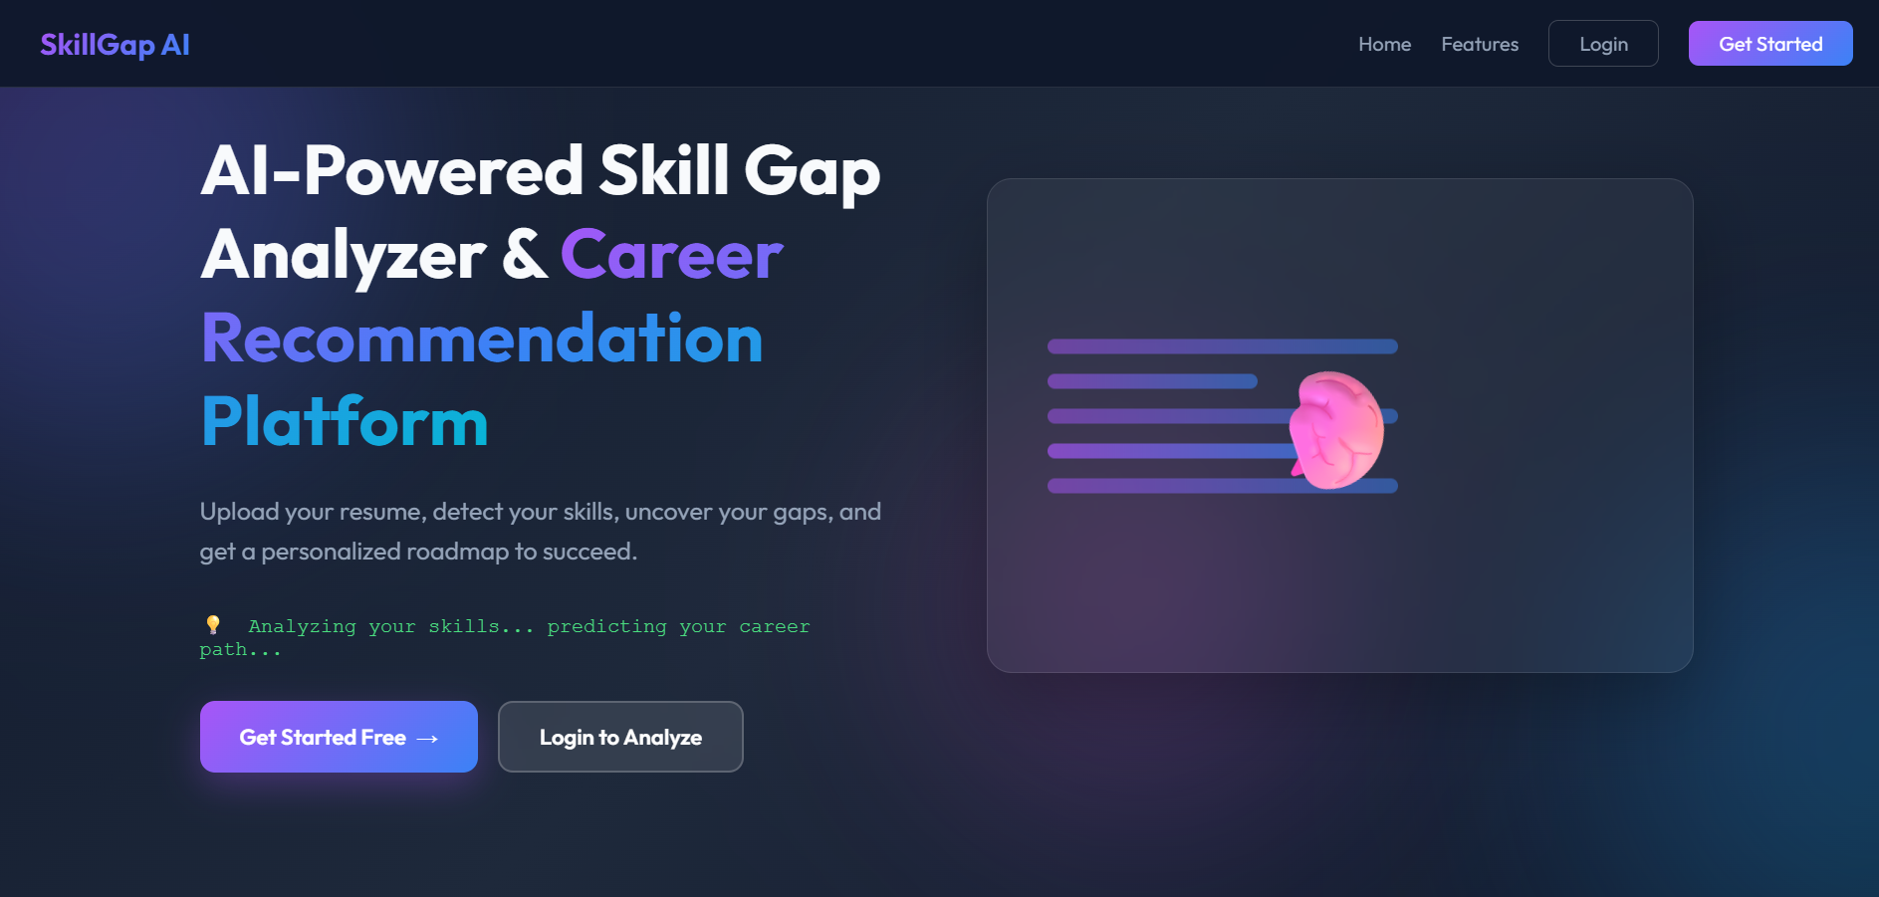
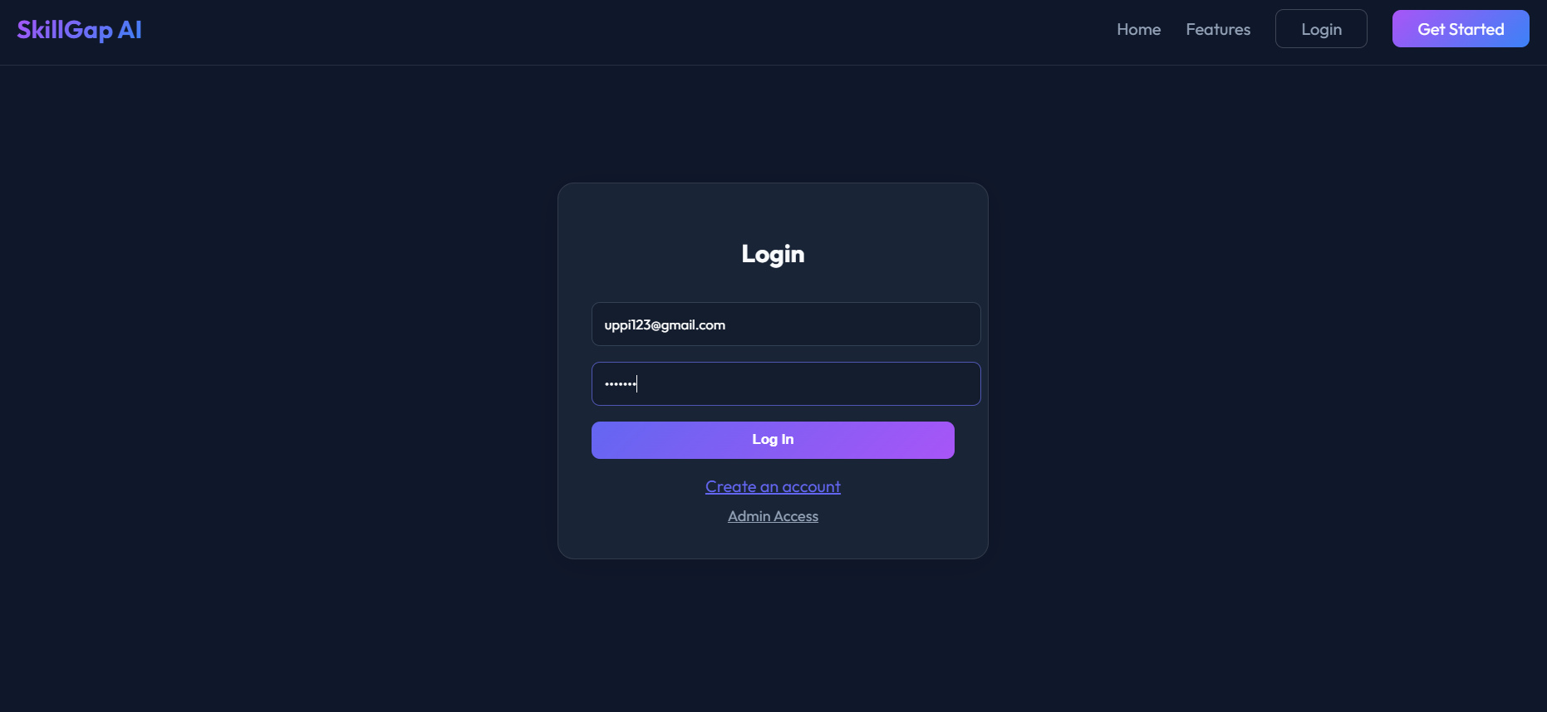
Implementation
Screenshots
Home Page
User Login Page

Slide 21
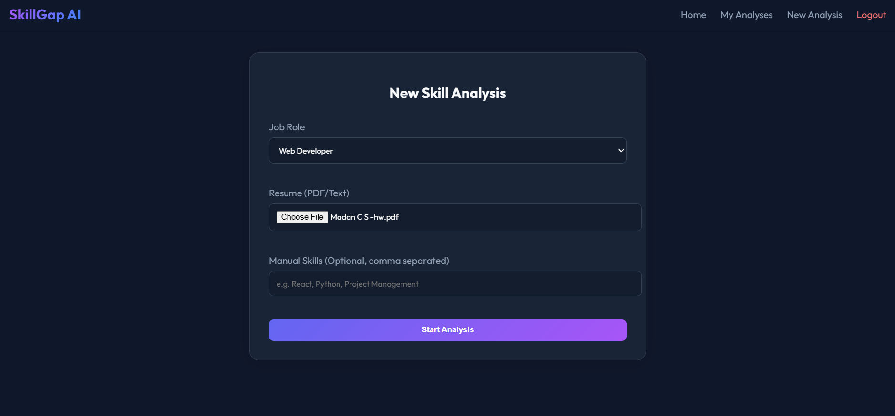
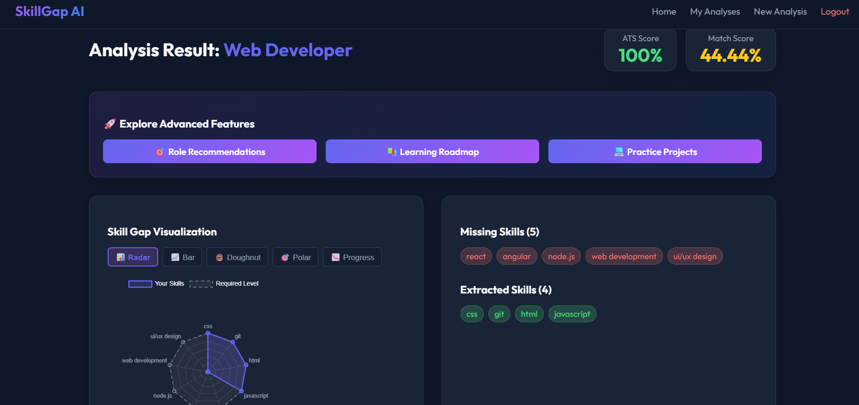
Resume Upload Page
Analysis Page

Slide 22
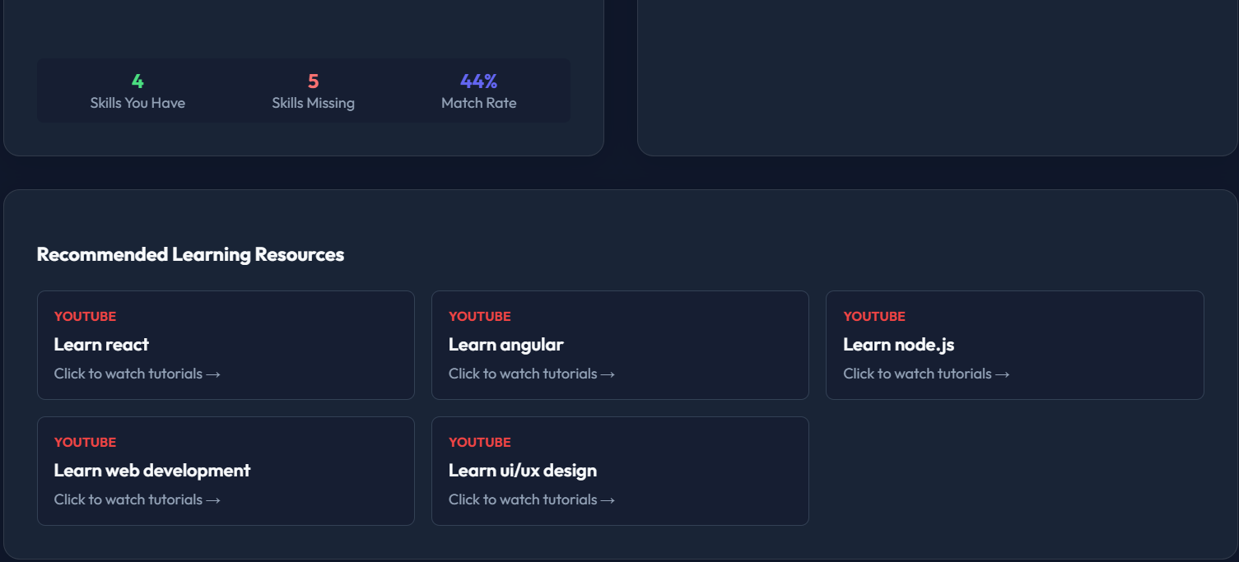
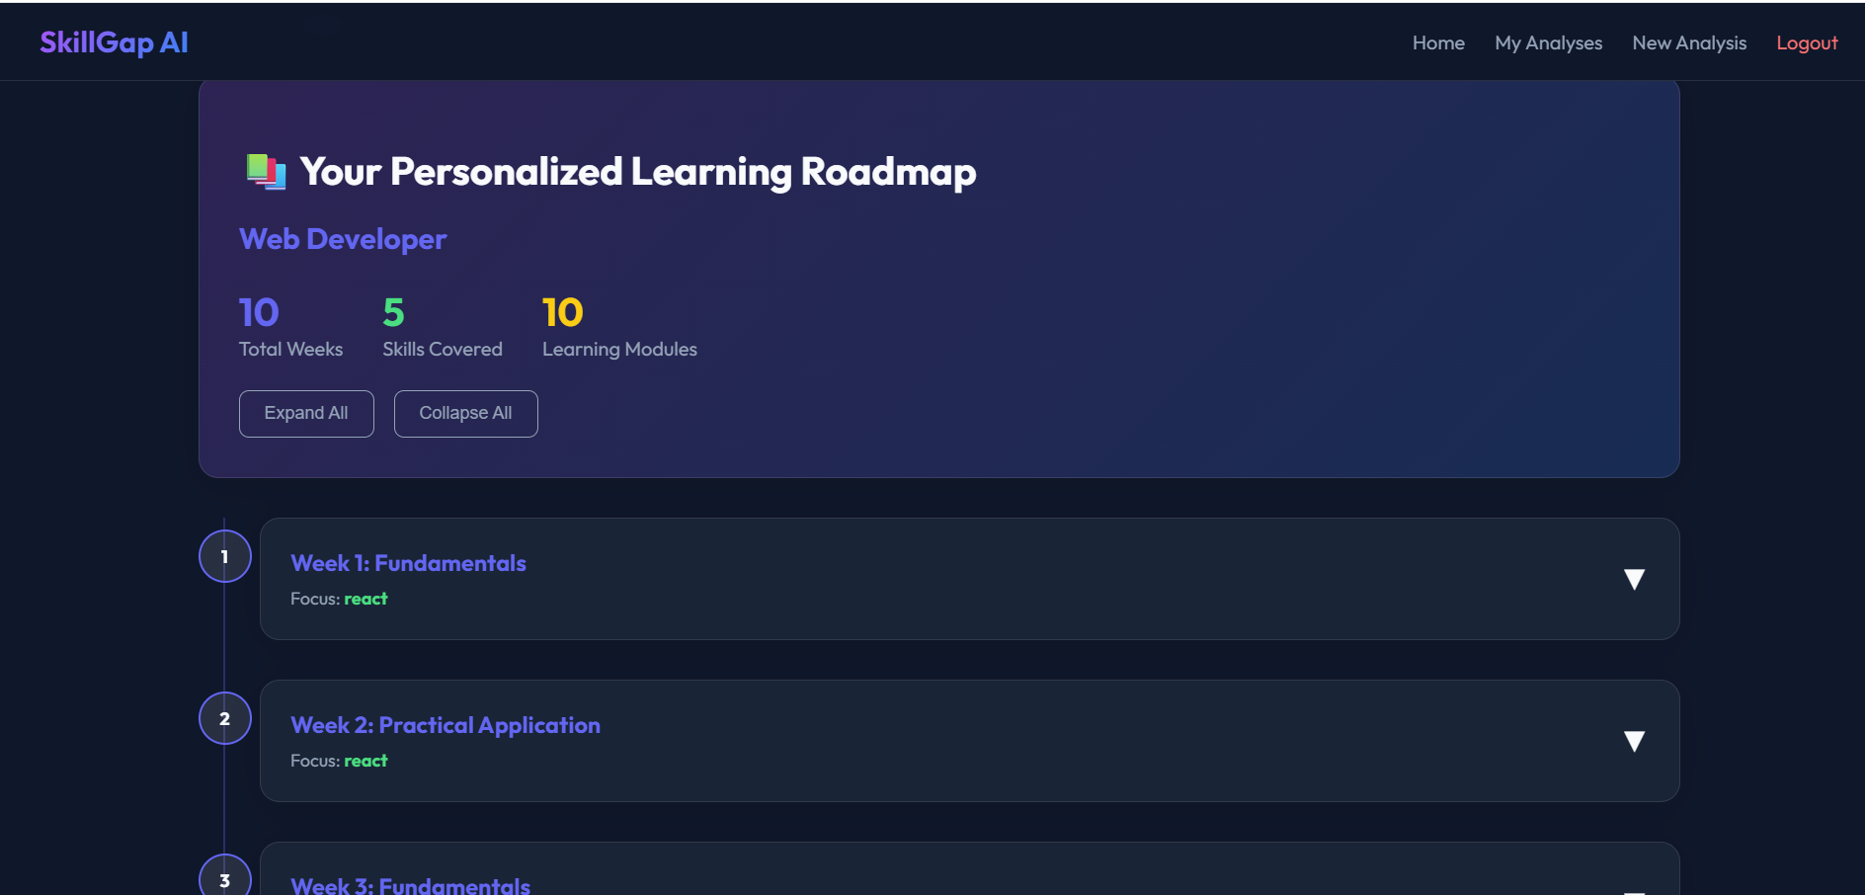
Youtube Video Recommendation
Learning Roadmap Page

Slide 23
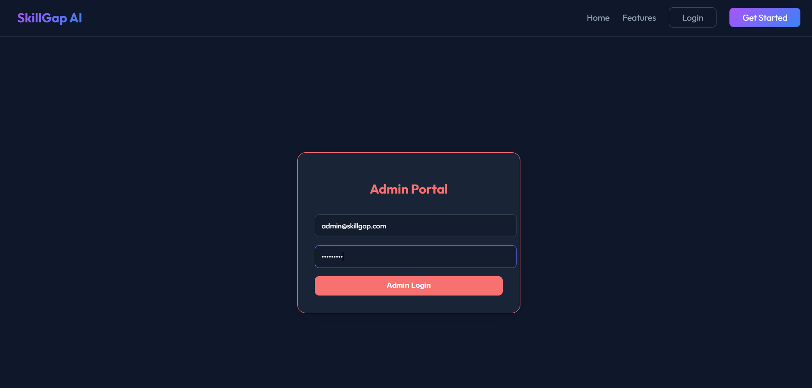
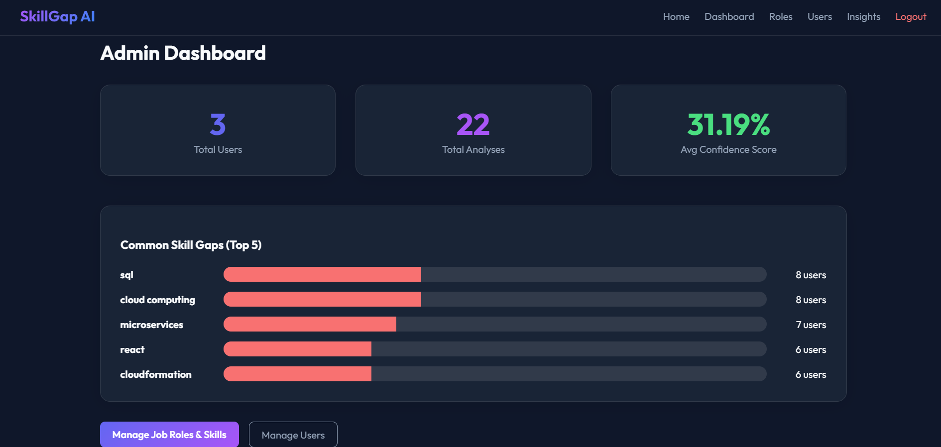
Admin Login Page
Admin Dashboard

Slide 24
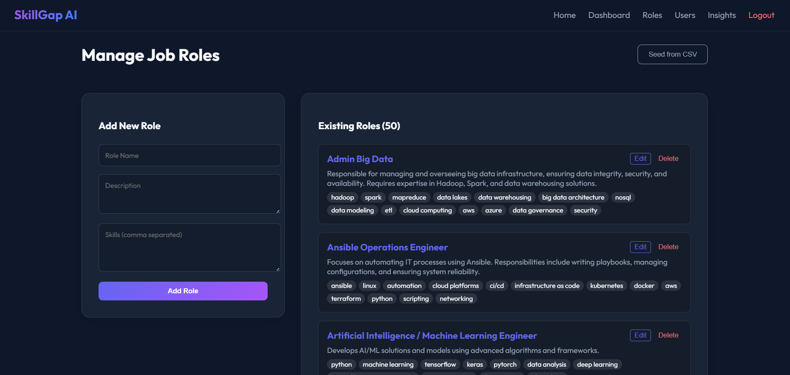
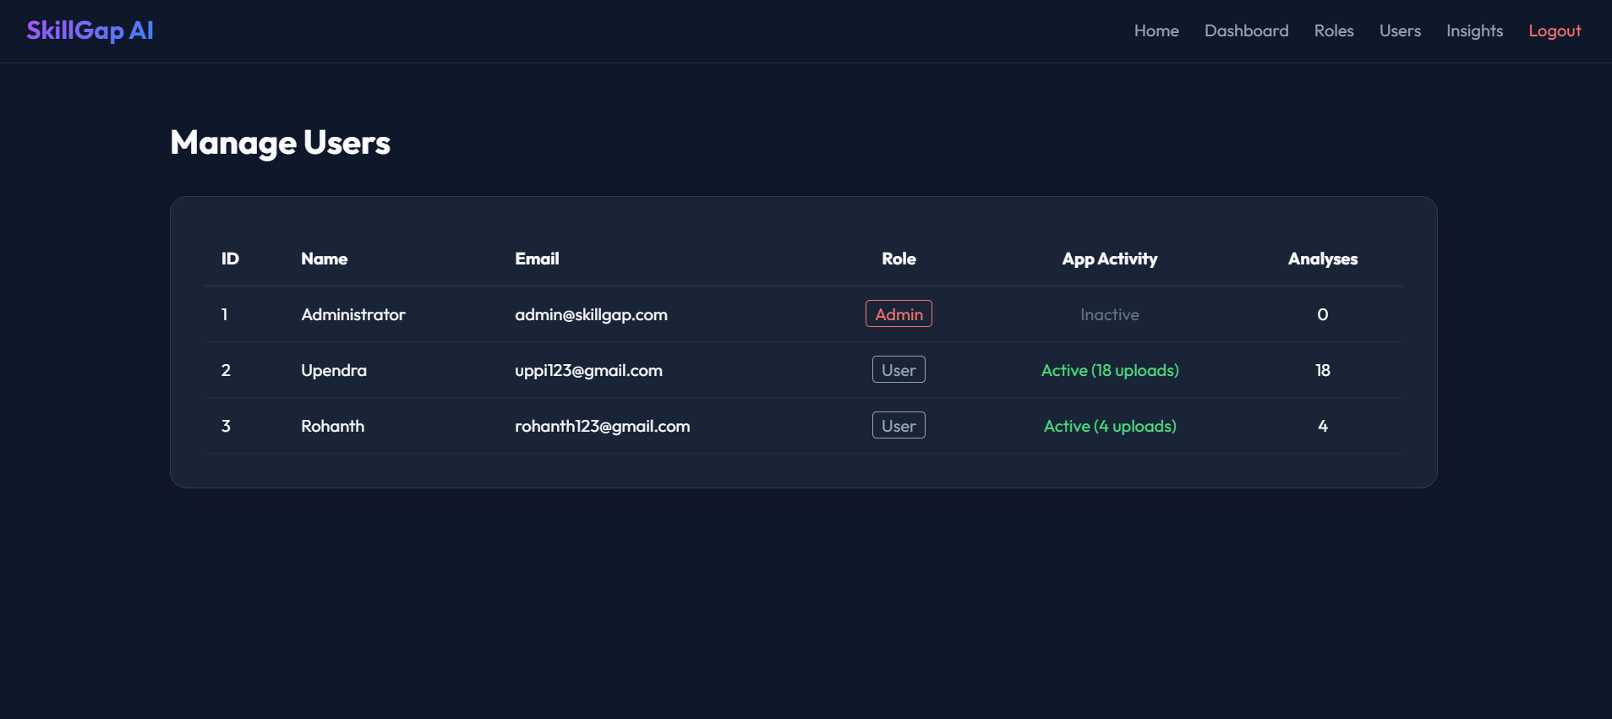
Manage Job Role Page
User Manage Page

Slide 25
Software Testing
Test Case ID | Test Case Name | Test Description | Test Input | Expected Result | Actual Output | Status
TC01 | Admin Login | Validates admin login | Valid admin credentials | Redirect to admin dashboard | Login successful | Pass
TC02 | Job Seeker Login | Verifies job seeker authentication | Valid username and password | Redirect to user dashboard | Login successful | Pass
TC03 | Job Seeker Registration | Registers a new job seeker | Valid user details | Account created successfully | Account created | Pass
TC04 | Invalid Login | Prevents access for invalid credentials | Invalid username/password | Error message displayed | Access denied | Pass
TC05 | Resume Upload | Uploads resume file | PDF file | Resume uploaded | Upload successful | Pass
TC06 | Resume Parsing | Extracts skills from resume | Resume file | Skills extracted and stored | Skills extracted | Pass
TC07 | Skill Gap Analysis | Identifies missing skills | Resume + job role | Skill gaps displayed | Gaps identified | Pass
TC08 | Job Role Recommendation | Suggests suitable job roles | User skill profile | Recommended roles shown | Roles displayed | Pass
TC09 | Learning Roadmap | Generates learning plan | Selected job role | Roadmap generated | Roadmap displayed | Pass
TC10 | Practice Project Recommendation | Suggests practice projects | Skill gaps | Project list displayed | Projects shown | Pass
TC11 | Dashboard View | Displays user progress | Logged-in user | Dashboard loaded | Dashboard displayed | Pass
TC12 | Admin Manage Users | Displays user list | Admin access | User details shown | Users listed | Pass
TC13 | Admin Manage Job Roles | Adds new job role | Role details | Role added successfully | Role added | Pass
TC14 | Logout | Terminates user session | Logout action | Redirect to login page | Logged out | Pass

Slide 26
Conclusion
The AI-Based Skill Gap Analyzer and Personalized Learning Recommendation System successfully integrates Artificial Intelligence, Machine Learning, and Natural Language Processing to analyze resumes and evaluate user competencies. The system accurately identifies existing skills, detects skill gaps, and recommends suitable learning paths based on industry requirements.
By automating skill assessment and recommendation processes, the system reduces manual effort, improves decision accuracy, and supports users in planning their career development effectively. The project demonstrates a scalable, reliable, and user-friendly solution that can be extended for real-world educational and professional platforms.

Slide 27
Future Enhancements
Integration with job portals (LinkedIn, Indeed)
Advanced ML models for better accuracy
Mobile app development
Real-time job market trend analysis
Multi-language support for global users

Slide 28
THANK YOU

